Slide 1



Engineering Electromagnetics 工程电磁场
Youwei Jia 嘉有为

Slide 2

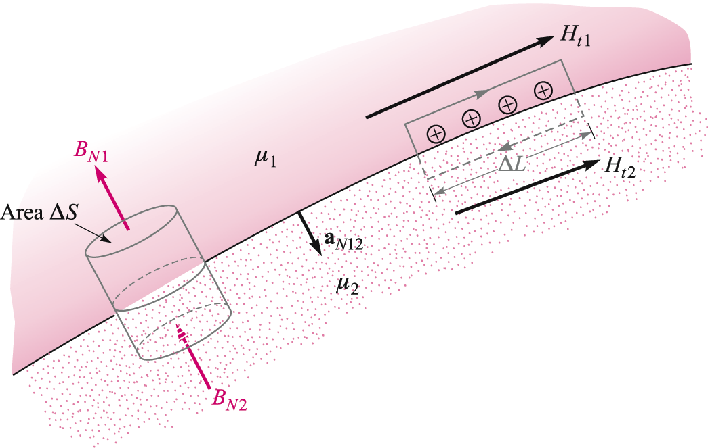
11: The Steady Magnetic Field
Magnetic Field Boundary Conditions
Consider an interface between two media that have different permeabilities 磁导率.
We want to find the relationship between magnetic fields at the boundary, on either side. This is done by considering separately the normal and tangential components of the field.
35

Slide 3
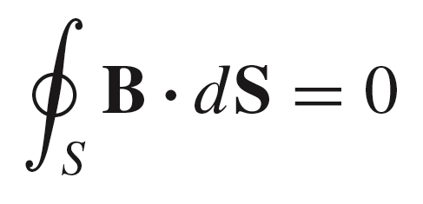
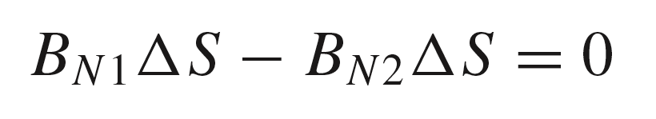
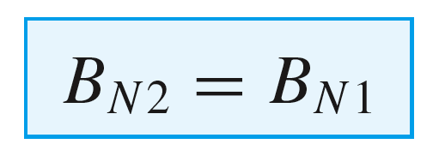
11: The Steady Magnetic Field
Boundary Condition for the Normal Component of B
In this case, we use Gauss’ Law for the magnetic flux density:
..and apply this to the right circular cylinder as shown:
obtain:
so that:
The normal component of B is continuous across a boundary.
36

Slide 4
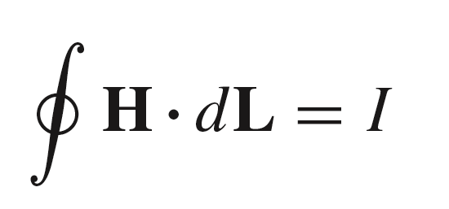
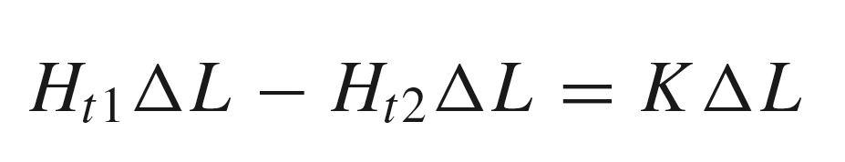
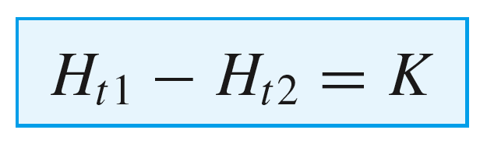
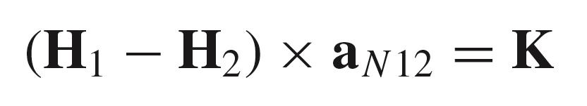
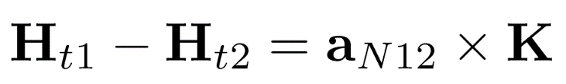
11: The Steady Magnetic Field
Boundary Condition for the Tangential Component of H
In this case, we allow for the possibility of a
surface current density, K, at the boundary, as shown.
Ampere’s Circuital Law states:
K
..and over the indicated path, this becomes:
or:
More generally:
or
Obviously, if no surface current exists, then the two tangential fields are equal at the boundary!
37

Slide 5
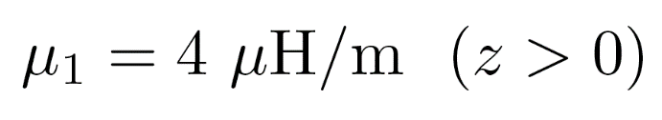
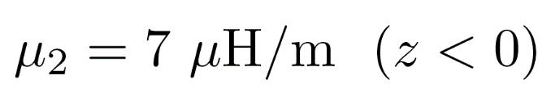
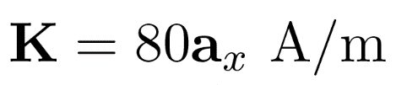

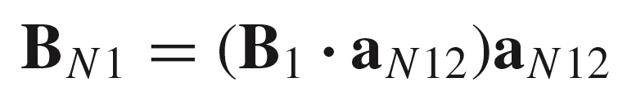
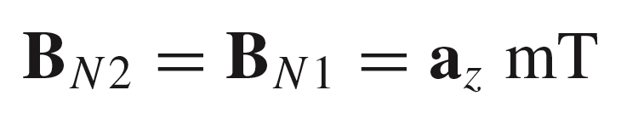
11: The Steady Magnetic Field
Example (8.6)
Given, a configuration
for which:
at z = 0
Find B₂
First, we work with the normal components:
Therefore:
38

Slide 6
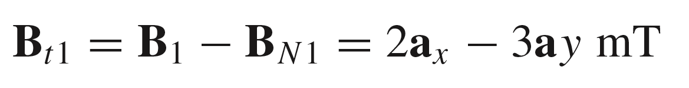
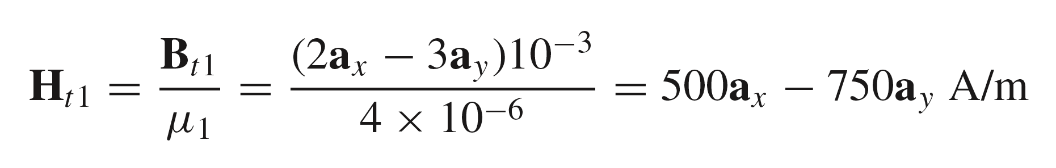
11: The Steady Magnetic Field
Example (8.6 Cont’d)
Next, we work with the tangential components:
39

Slide 7
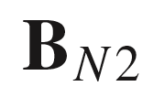
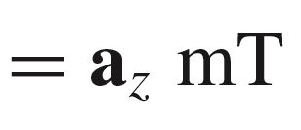
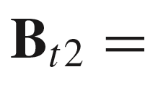
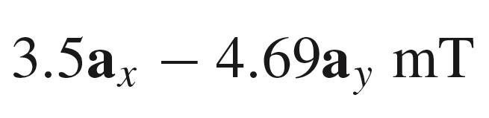
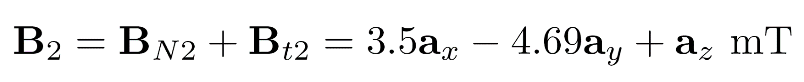
11: The Steady Magnetic Field
Example (8.6 Cont’d)
Summarizing, we have:
..so finally:
40

Slide 8
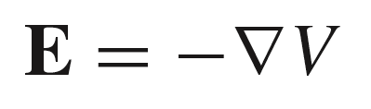
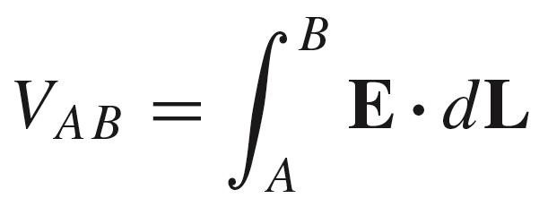
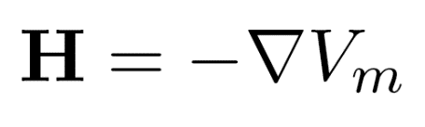
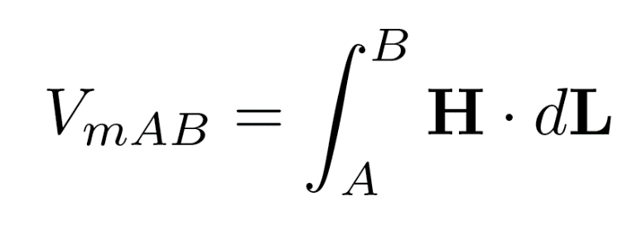
11: The Steady Magnetic Field
E and H -- and Related Potentials
Electric field -- electric
potential relations:
Magnetic field -- scalar
magnetic potential relations:
V_{m} is the magnetomotive force磁动势, or mmf. Unit: A.t 安匝
41

Slide 9
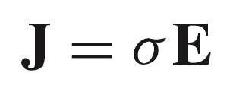
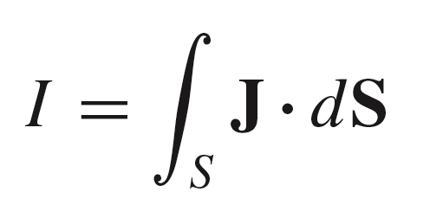
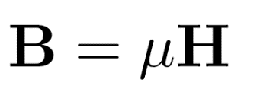
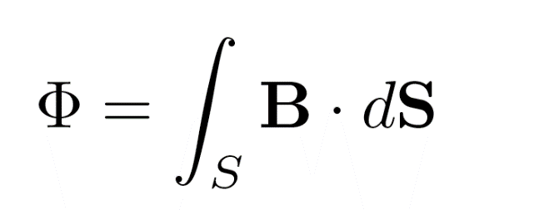
11: The Steady Magnetic Field
Ohm’s Law and Current Analogies 用电路模拟磁路
Point form of Ohm’s Law
for the electric field:
Current flux:
Analogy to Ohm’s Law
for the magnetic field:
B assumes the role of
current density
Magnetic “current” flux:
42

Slide 10
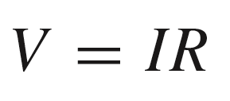
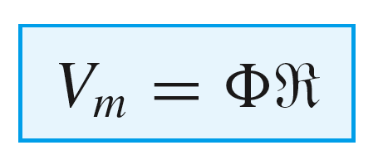

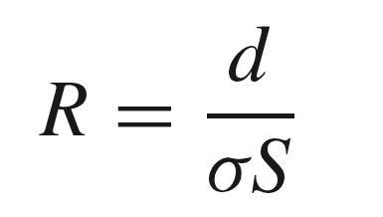
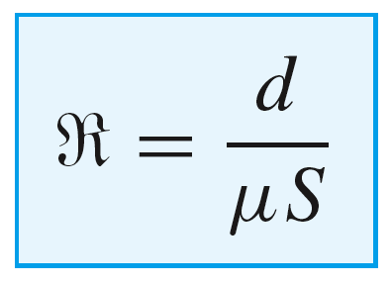
11: The Steady Magnetic Field
Reluctance as an analogy to Resistance 磁阻 vs 电阻
In large scale form, Ohm’s Law is:
A similar rule can be constructed
that relates mmf to magnetic flux:
This is the analogous
equation for Ohm’s Law
in a magnetic circuit 磁路
where is the reluctance 磁阻 of the medium, in direct analogy to resistance.
For a straight wire of uniform conductivity, we found that:
For a similar medium of uniform permeability, it follows that:
43

Slide 11
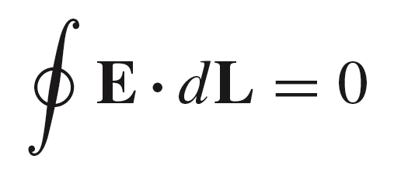
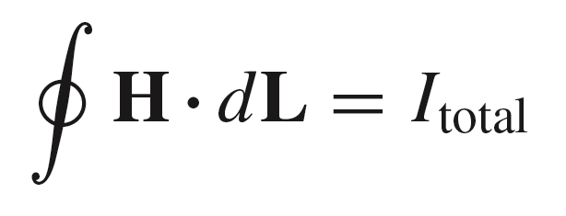
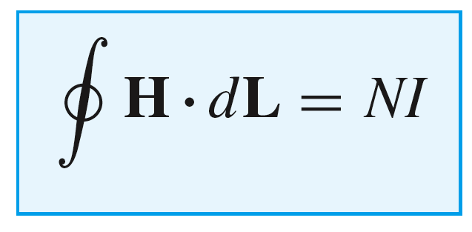
11: The Steady Magnetic Field
Analogy to Source Voltage
In an electric circuit, Kirchoff’s
Voltage Law is expressed as:
The magnetic analogy is expressed
as Ampere’s Circuital Law:
Generally, the closed path integral of H may include N turns of wire, leading to:
This quantity is the mmf around a closed
path, which we use as V_{m} in our magnetic
circuit equation.
44

Slide 12

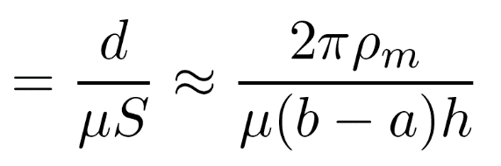

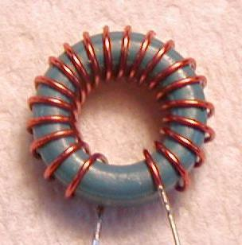
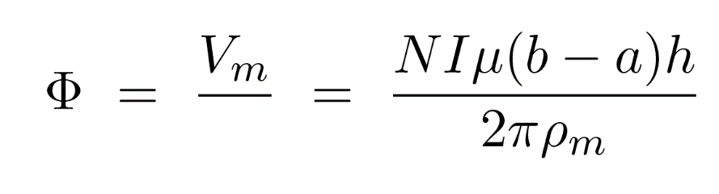
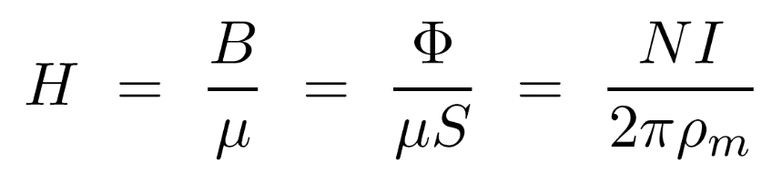

11: The Steady Magnetic Field
Application of Reluctance: A Simple Magnetic Circuit
To see how reluctance is used, consider
this example, involving a toroid of rectangular
cross-section, in which the inner and outer radii
satisfy the condition b - a << b.
y
x
x
x
N turns
x
H
x
.
.
.
.
x
.
x
.
.
In this case, we can approximate the
reluctance as:
x
.
.
x
.
.
C
x
.
.
x
x
.
I
a
.
x
.
b
.
x
.
.
.
x
x
so that the flux becomes:
x
x
x
x
x
h
..and finally:
a
b
45

Slide 13
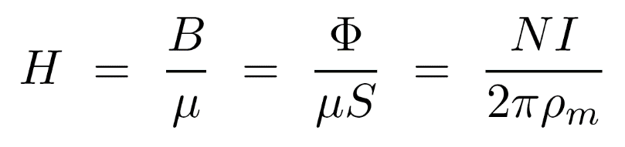
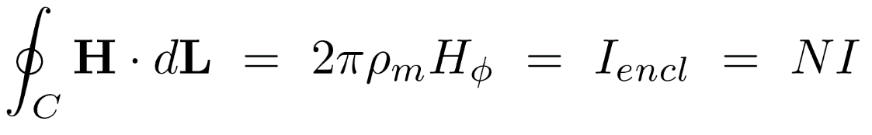
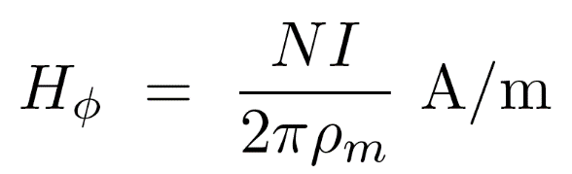
11: The Steady Magnetic Field
Two Ways of Finding H
y
Note that this result:
x
x
H
x
N turns
x
.
x
.
.
.
.
x
.
x
.
x
.
.
x
.
.
C
..is the same as that found using Ampere’s
circuital law at the mean radius, giving the
magnetic field at that location:
x
.
.
x
x
.
I
a
.
x
.
b
.
x
.
.
.
x
x
x
x
x
x
x
h
a
b
46

Slide 14

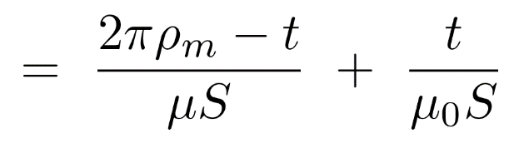
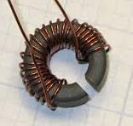

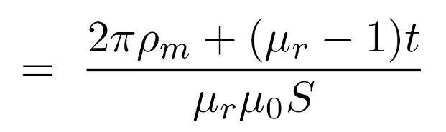
11: The Steady Magnetic Field
Toroid with Air Gap
Suppose that an air gap exists in the
core, having thickness t, as shown.
y
x
x
x
N turns
The reluctance of the magnetic circuit will
be the series combination of the core reluctance and that of the air gap:
Air Gap
(free space
permeability)
x
x
H
.
x
x
.
.
.
.
.
.
x
x
.
.
.
C
.
a
.
x
x
I
.
b
.
t
x
.
.
.
.
.
x
x
x
The core permeability is
x
x
x
x
x
with which the total reluctance is now:
h
a
b
47

Slide 15

11: The Steady Magnetic Field
Approximations for Ferromagnetic Core
If the core is ferromagnetic, the relative
permeability will be on the order of several
thousands, in which case the air gap contribution to the reluctance may dominate, even though the gap dimension is very small.
y
x
x
x
N turns
Air Gap
(free space
permeability)
x
x
H
.
x
x
.
.
.
.
.
.
x
may neglect
x
.
.
.
C
.
a
.
x
x
I
.
b
.
t
x
.
.
.
.
.
x
x
x
If t is even a small fraction of the core circumference,
the net reluctance can often be taken as that of the air gap.
x
x
x
x
x
Another assumption is that the gap thickness is
small enough so that fringing magnetic fields
can be neglected.
h
a
b
48

Slide 16

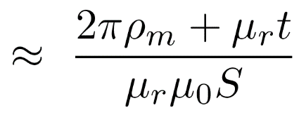
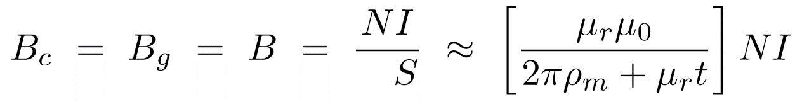



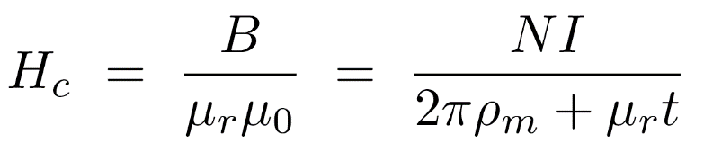
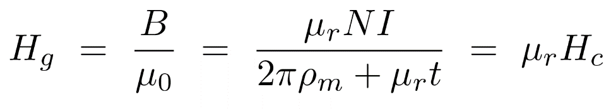
11: The Steady Magnetic Field
Magnetic Field in Core and Air Gap
We assume that
…so that the net reluctance approximates as:
The magnetic flux density is the same in the core and in the air gap
(remember the boundary condition for B normal to an interface)
H_{c}
t
H_{g}
The magnetic field strengths in each region are now:
H_{c}
Core material:
Air gap:
49

Slide 17

11: The Steady Magnetic Field
Nonlinear Relation between B and H
In ferromagnetic materials, B increases with increasing H, but in a nonlinear manner as shown in the typical curve below
So we really don’t know what the actual permeability is until we have definite knowledge of B or H.
50

Slide 18








11: The Steady Magnetic Field
Procedure for Including the Nonlinear B-H Characteristic
Consider again the toroid with mean radius and air gap of thickness t.
We already found that:
and that:
..so the problem is this:
given
unknown
The procedure is to assume a value for B, solve the
equation for , and then use that result to find H_{c}
unknown
using the actual B-H curve.
This, along with:
must satisfy Ampere’s Circuital Law:
If not, try again with a corrected value for B, over as many iterations 迭代 as needed.
51

Slide 19

11: The Steady Magnetic Field
A Further Complication: Hysteresis 磁滞回线
Increasing H to high positive values lines up all
magnetic moments, and a single domain is
left (in the extreme case). The core is thus in
Saturation 饱和. Further increase in H leads to an
increase in B through the free space permeability
Domain wall 磁畴壁 shifting in ferromagnetic materials introduces
semi-permanent magnetization states that are slow to respond to
changes in applied magnetic fields. The resulting magnetization
curve demonstrates the hysteresis phenomenon as shown here.
Decreasing the applied H field to zero leaves many dipoles
still aligned, and we have the remnant magnetic flux density,
B_{r} 剩余磁通密度. The material has become a permanent magnet.
Coercive field in transistioning
B from negative to positive values
The remnant flux density is reduced to zero by applying
an opposing magentic field strength, -H_{c} known as the
coercive field (or coercive force). 矫顽力
Remanant magnetic flux density, for increasing H
field from negative to positive values
Increasing H to high negative values again
leads to saturation
52

Slide 20


11: The Steady Magnetic Field
Magnetic Circuit in Rectangular Geometry
This problem is handled in the same way as before, except that the perimeter is constructed using the mean distances, L₁ and L₂ .
53

Slide 21




11: The Steady Magnetic Field
Energy and Energy Density in the Magnetic Field
In a previous lecture it was demonstrated that the energy in the electric field within volume v is given by:
In like manner, it would seem logical that the magnetic field energy within volume v is:
Energy density relations are as previously found, or as expected:
and
valid for isotropic media
54

Slide 22



11: The Steady Magnetic Field
Magnetic Flux 磁通 and Flux Linkage 磁链
Consider a solenoid of length d, which carries current I in each of N turns 匝. The turns have individual areas S_{i} which may be different from each other. The B field may also evaluate differently in each turn.
B
The Flux Linkage is defined as the sum of the magnetic fluxes through
all turns, where the flux evaluated at each surface is the total flux there,
generated by all turns acting together.
N turns
I
d
where
S_{i}
Units of flux linkage are Weber-turns [Wb-t]
If all turns (and B through each) are equal, then the above simplifies to:
where the integral is evaluated
over any single turn.
55

Slide 23

11: The Steady Magnetic Field
Inductance Definition 电感的定义
Having the flux linkage:
B
where
The inductance of the device is defined as the flux linkage per unit current, or
N turns
I
d
where the last equality applies if all
turns are identical
S_{i}
The units of inductance are Weber-turns per Ampere, where
1 Wb-t/A is defined as one Henry [H].
56

Slide 24








11: The Steady Magnetic Field
Solenoid Inductance
For a long solenoid, having turn density n, and core permeability ,
the magnetic flux density has magnitude:
B
Then, assuming equal flux densities through N identical turns,
the flux linkage is
N turns
I
d
S_{i}
…and the inductance is:
It is interesting to compare this result to the capacitance
of a parallel-plate capacitor, having plate area S, plate
spacing, d, and dielectric permittivity, :
57

Slide 25

11: The Steady Magnetic Field
Departure from the Ideal
In reality, flux density generated by each turn may not link the entire coil. Such fringing fields 边缘场, shown here, may link only one or two turns.
The problem is made worse by increased winding pitch 匝距.
58

Slide 26







11: The Steady Magnetic Field
Example: Inductance of a Coaxial Line
Consider a length d of coax, as shown here. The magnetic field strength between conductors is:
and so:
The magnetic flux is now the integral of B over the
flat surface between radii a and b, and of length d along z.
As we have only one turn (N = 1), the result is also the flux linkage:
B
d
Now, with d = 1, the inductance per unit length is:
59

Slide 27




11: The Steady Magnetic Field
Two Inductors
Suppose we have two solenoids, having different specifications as indicated:
B₂₂
The self linkage and self inductance 自感of each coil are determined in the manner that we used before, assuming identical fluxes through each turn.
Coil 2
d₂
N₂
S₂
I₂
and
B₁₁
Coil 1
d₁
N₁
S₁
I₁
and
60

Slide 28
11: The Steady Magnetic Field
Interaction Between Inductors
B₁₂
B₂₂
Actually, the magnetic fields generated by each coil will link the other,
as shown here. This flux overlap is the basis of mutual inductance.
Throughout this discussion, the field in red is that generated by Coil 1,
while the blue field is generated by Coil 2
Coil 2
d₂
N₂
With both currents on, all the fields indicated here will be present.
The fields and other quantities are kept track of by the subscripts,
the meaning of which is:
S₂
I₂
B_{i j}
B₁₁
B₂₁
arising
from coil i
evaluated
within coil j
d₁
N₁
Coil 1
i, j = 1, 2
S₁
I₁
61

Slide 29


11: The Steady Magnetic Field
Mutual Inductance互感, M₁₂
B₁₂
In this case, current in Coil 2 is turned off, leaving only the flux density
generated by Coil 1, B₁₂ , existing within Coil 2.
Coil 2
d₂
N₂
The mutual linkage between Coils 1 and 2 is found through:
S₂
I₂ = 0
B₁₁
… and the mutual inductance between Coils 1 and 2 is defined as:
Coil 1
d₁
N₁
S₁
I₁
62

Slide 30


11: The Steady Magnetic Field
Mutual Inductance, M₂₁
B₂₂
In this case, current in Coil 1 is turned off, leaving only the flux density
generated by Coil 2, B₂₁ , existing within Coil 1.
d₂
The mutual linkage between Coils 2 and 1 is found through:
Coil 2
N₂
S₂
I₂
… and the mutual inductance between Coils 2 and 1 is defined as:
B₂₁
Coil 1
d₁
N₁
S₁
I₁ = 0
Q: What are the key factors affecting mutual inductance?
63

Slide 31



11: The Steady Magnetic Field
Example: Concentric Solenoids 同轴螺线管
In this configuration, two concentric solenoids have different numbers of turns, N₁ and N₂ (even though in the drawing the turn count would appear to be the same). Both coils have the same length, d. The area of each identical turn in the two coils is S₁ for the outer coil, and S₂ for the interior coil. The core permeability is
N₁
d
N₂
S₁
S₂
64

Slide 32




11: The Steady Magnetic Field
Mutual Inductance, M₁₂
With the outer coil current I₁ turned on, the interior flux
exists throughout the outer coil volume, and consequently
throughout the volume of the inner coil as well.
B₁₂
Flux density B₁₂ resides inside coil 2 (and in coil 1 as well)
Assuming a long coil,
the flux density is:
N₁
I₁
d
The mutual linkage between coils 1 and 2 is then:
N₂
S₁
S₂
.. and the mutual inductance is:
B₁₁
65

Slide 33



11: The Steady Magnetic Field
Mutual Inductance, M₂₁
With the inner coil current I₂ turned on, the interior flux
exists throughout the inner coil volume, which overlaps with
the outer coil volume
B₂₁
Flux density B₂₁ resides inside coil 2 (and in coil 1 as well), but
the flux in the coil 1 volume is confined within the volume of coil 2.
The coil 2 flux density
(that resides in both coils) is:
N₁
d
N₂
The mutual flux linkage between coils 2 and 1 is then:
S₁
S₂
…and the mutual inductance is:
66

Slide 34

11: The Steady Magnetic Field
A Property of the Mutual Inductances
The foregoing example illustrates an important property of
the mutual inductances between any pair of inductors:
They’re equal!
67

Slide 35

HW-8
68

